Slide 1


Zillow Buyer/Seller
Analysis & Recommendations
DataSols
Akhilesh Pothuri
Sairam Gajavalli
Sai Teja Jonnala
Sai Vagbharathi Addagalla
Yukthi Gaddam
Sohan Ganampeta

Slide 2
Zillow Business Background
Zillow Group Inc. runs the top real estate website in the world where homeowners, agents, and anyone looking to purchase or rent homes can connect and conduct business.
The purchasing, selling, and renting of homes is coordinated by Zillow in order to facilitate sales of advertising spots and leads and generate commissions and interest.
The website is made to cover all aspects of homeownership, including buying, selling, renting, and loan financing.
Zillow’s mission is to arm consumers with the data and knowledge they need to make wise housing decisions.
Zillow generates revenue primarily from three sources: Homes, Mortgages and IMT (Internet, Media and Technology)

Slide 3
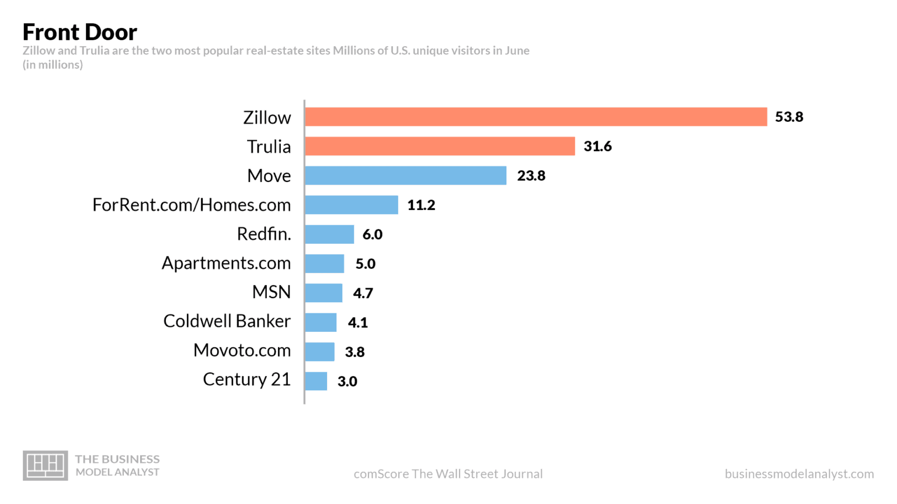
Primary Customers and Primary Competitors
Zillow has two distinct client segments that complement its objective to provide customers with high-quality real estate services
Service Consumers
The renters,
the homebuyers,
and the sellers
Service Providers
homeowners,
and professionals

Slide 4
Research Objective
Suggest/identify potential neighborhood areas for buyer to buy a home
Identifying best feature attributes to help boost sale listing while optimizing sale price of the house for seller
Suggest potential listing price based on the neighborhood area listings
Suggest affordability price range for the buyer to buy a house in a neighborhood area based on buyer's banking attributes (annual income, loan interest etc) -- AMBITIOUS

Slide 5
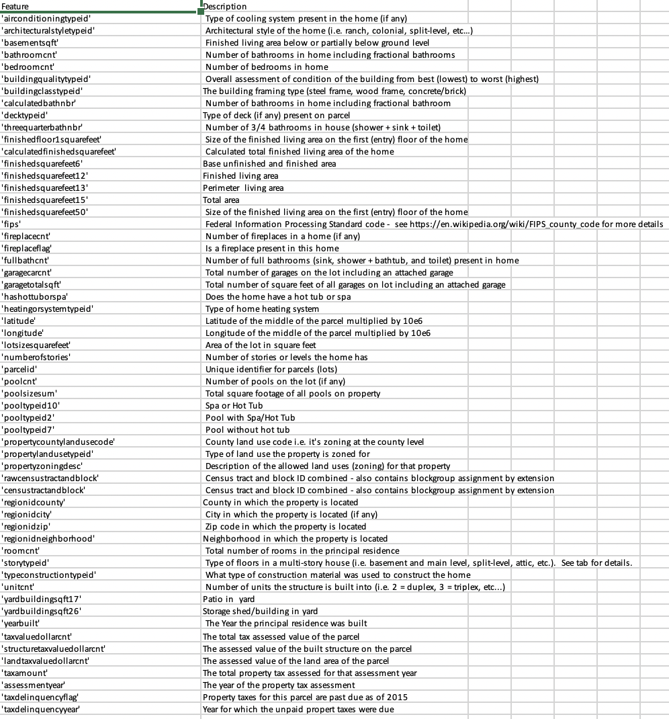
Dataset Description
Dataset contains full list of real estate properties in three counties (Los Angeles, Orange and Ventura, California) data in 2016 and 2017
All the properties with their home features: type of cooling system, architectural style of the home, number of bathrooms and number of bedrooms, total living area, number of garages, number of levels, year built, tax amount, assessment year, transaction date are among few features listed (total 58 features)
Location details (latitude, longitude, neighborhood, zip, city, county) area also included in the dataset.

Slide 6
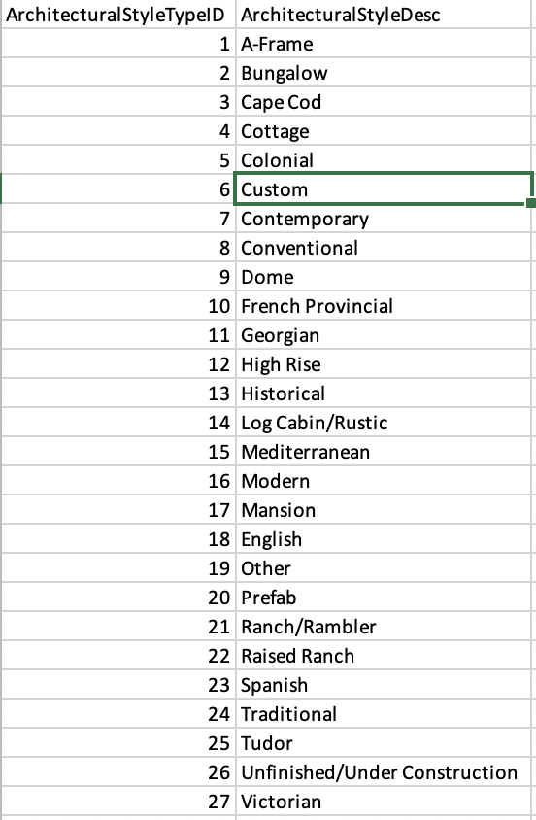
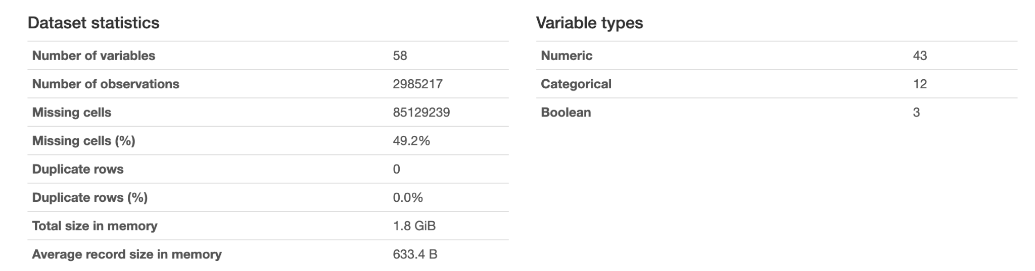
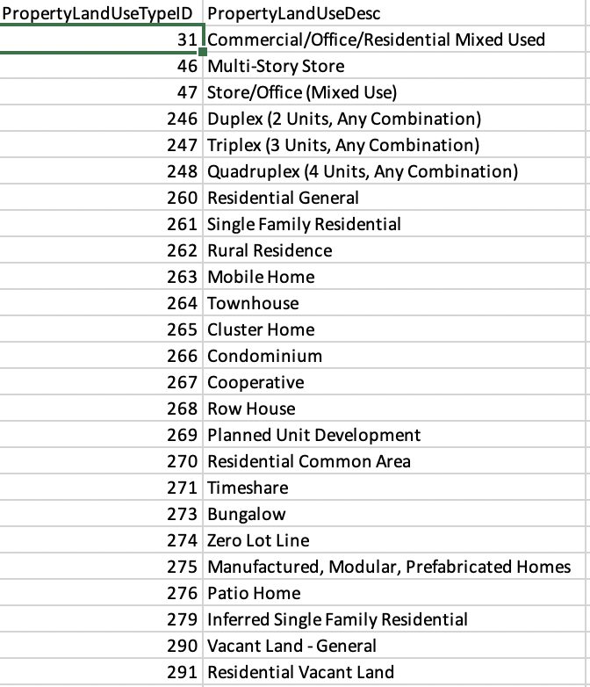
Data Description

Slide 7
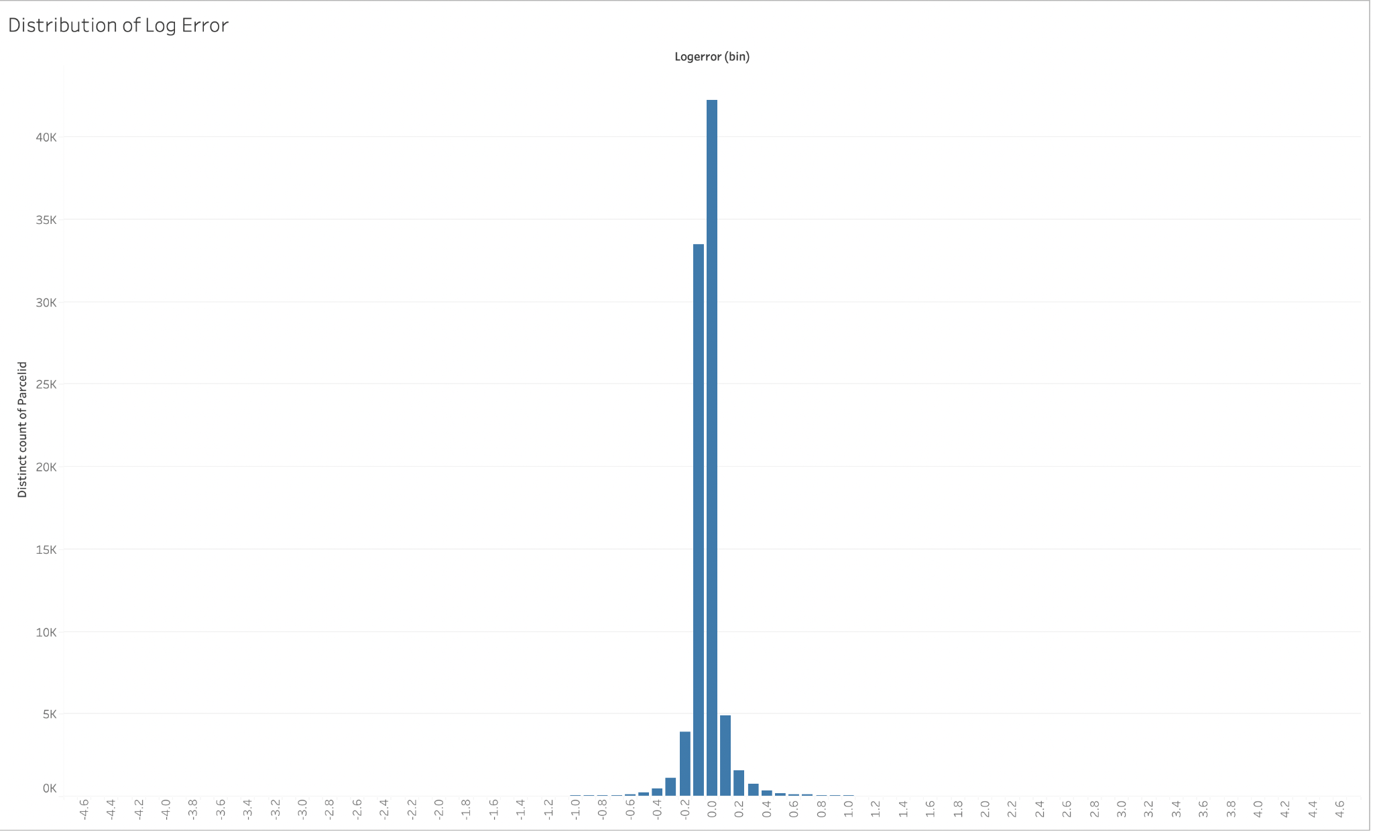
Understanding the Target Variable
Target Variable :
Logerror = log(Zestimate) - log(SalePrice)

Slide 8
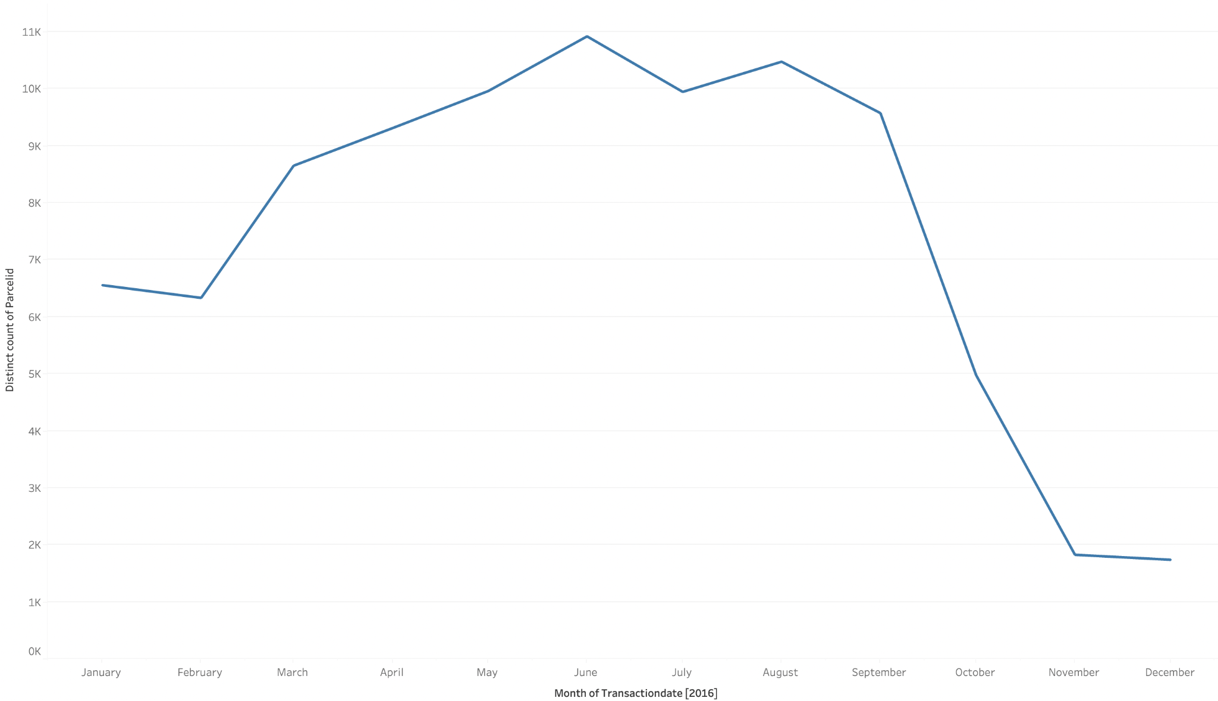
Data Cleaning and Preparation
Missing values
Distribution of the numerical variables
Outliers
Distribution of the categorical variables

Slide 9
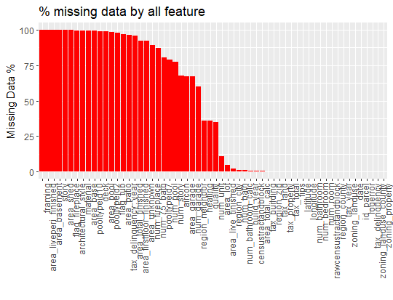
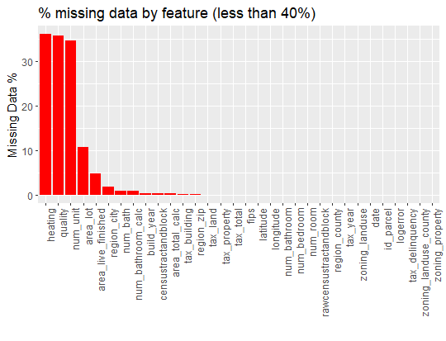

Slide 10
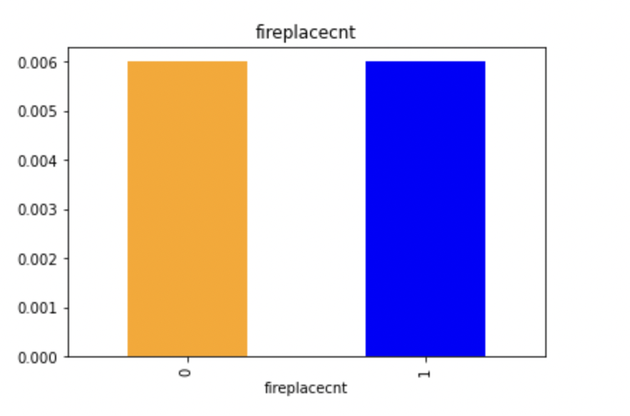
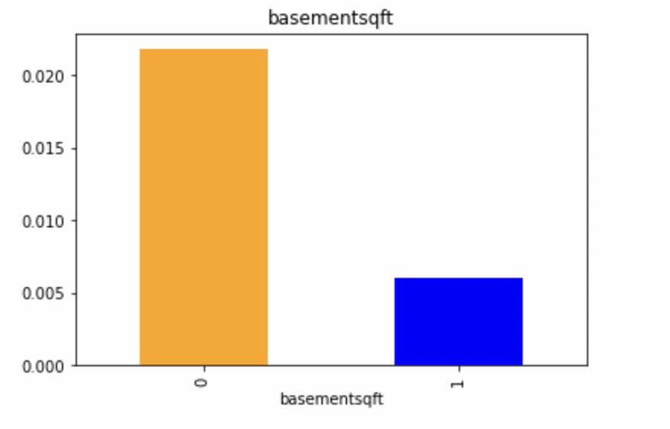
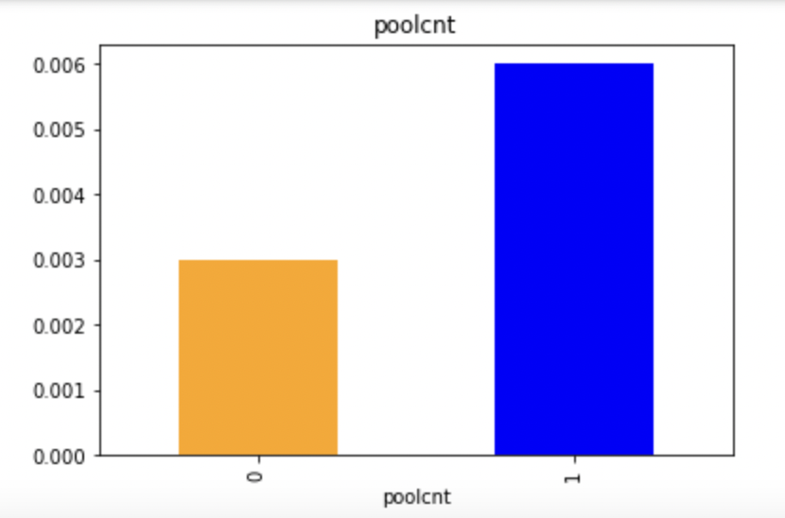
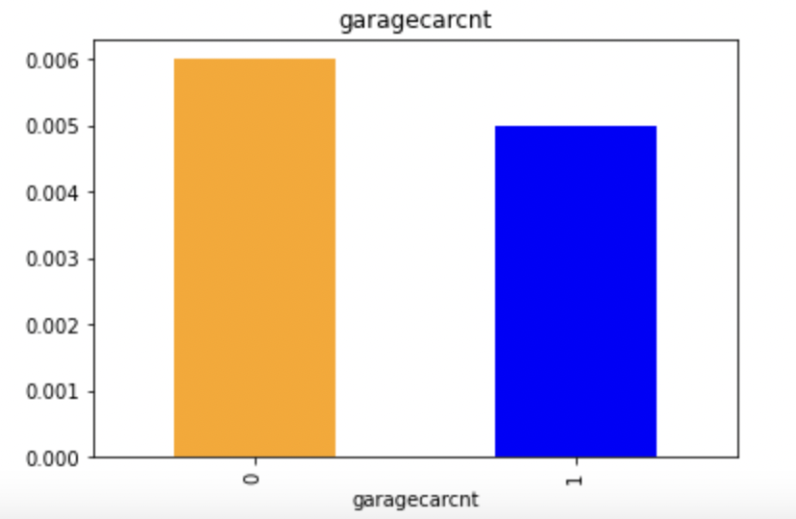
Exploratory Data Analysis on Missing Values

Slide 11
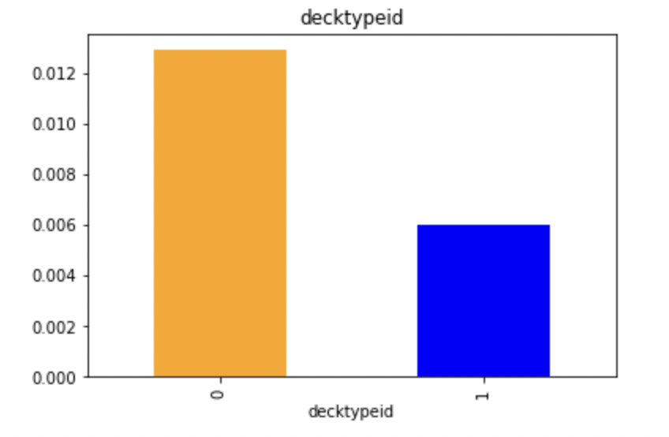
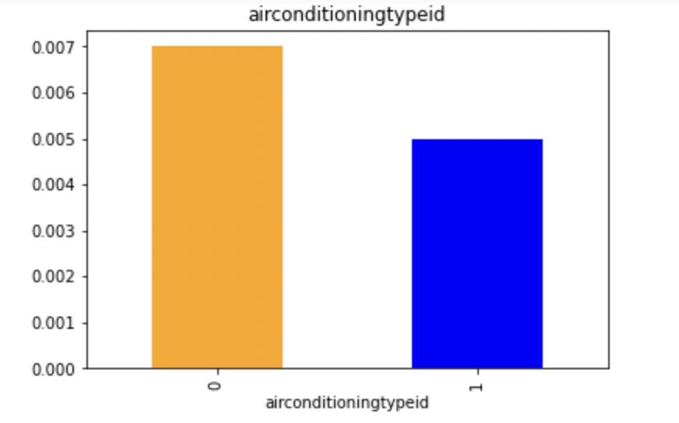
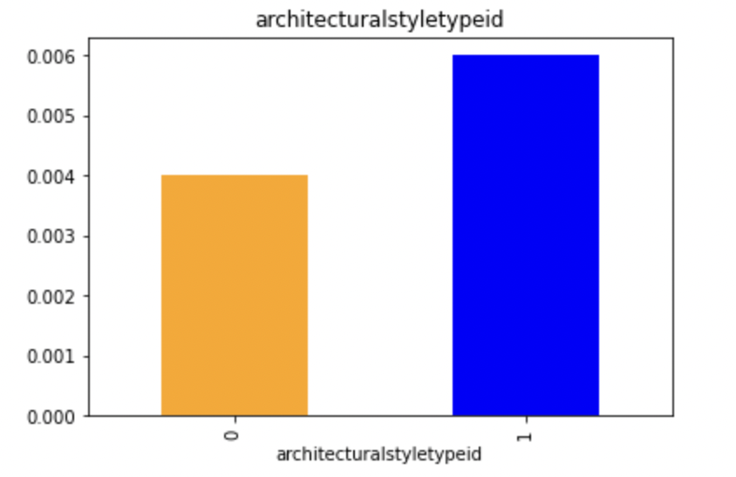
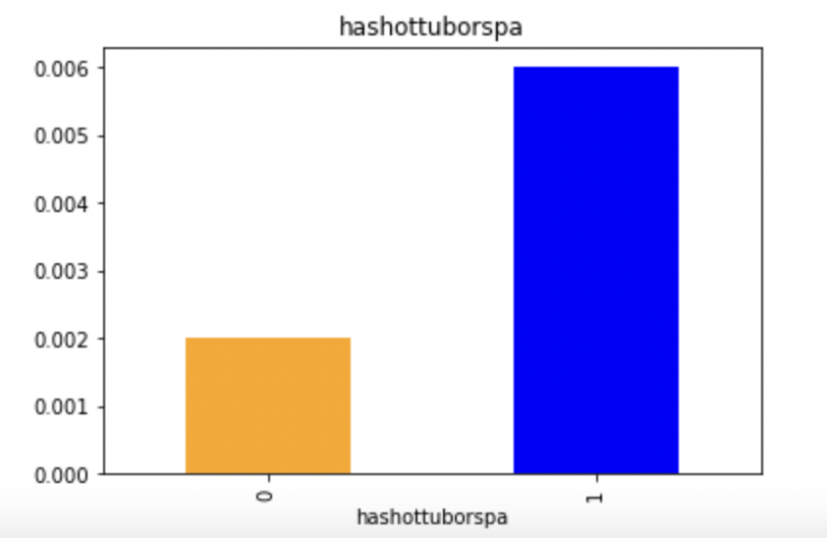
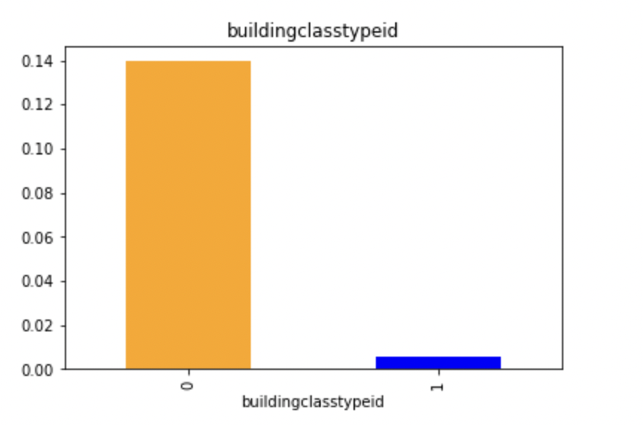
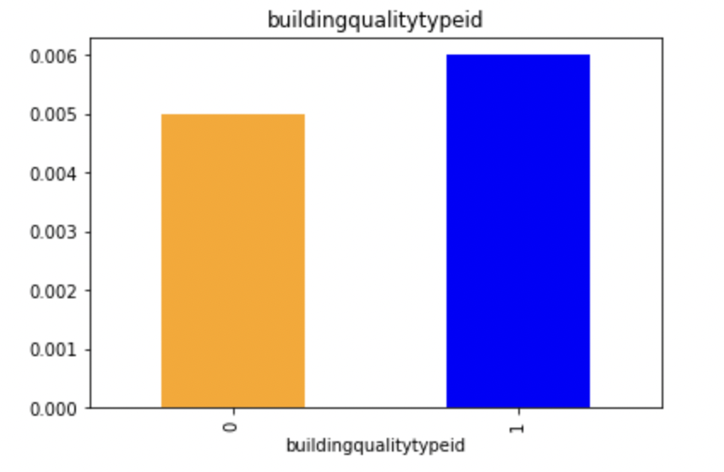

Slide 12
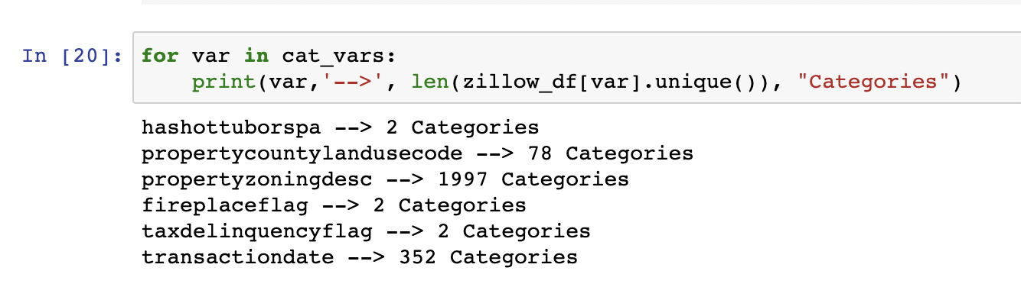
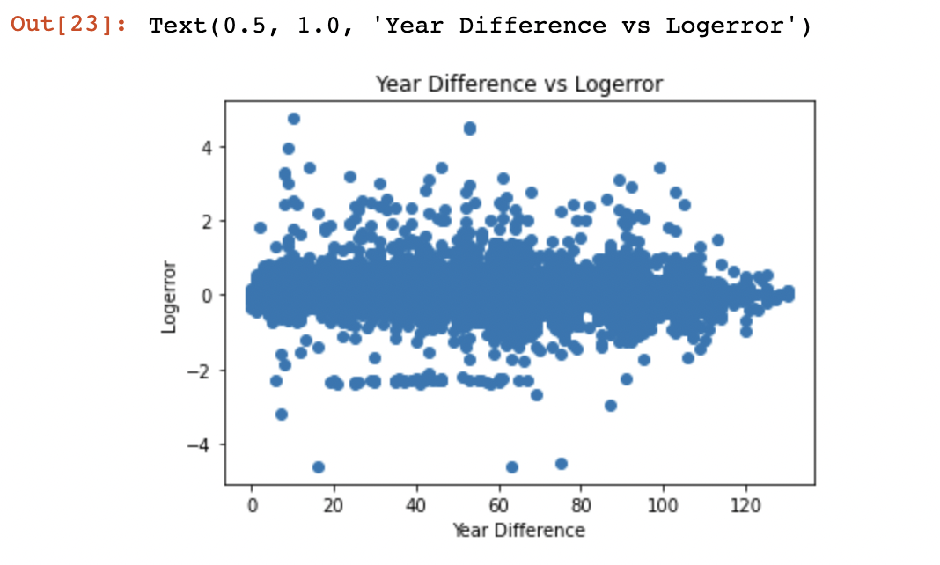
Distribution of Categorical Variables
Year Difference = Assessment Year - Year Built

Slide 13
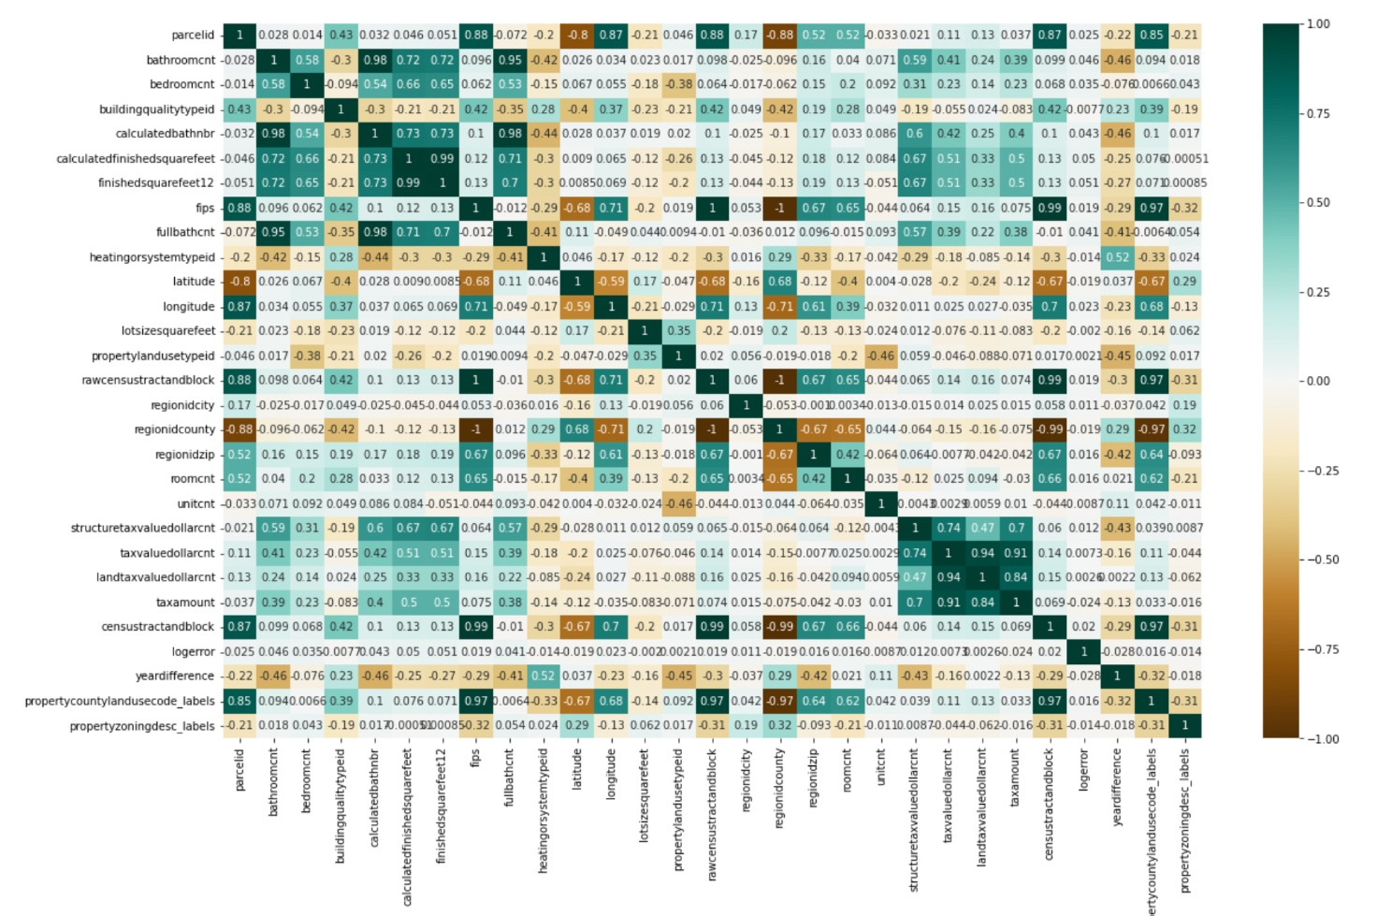
Multi-collinearity
Observation:
We observe high correlation among some of the feature variables from the above correlation plot.
Due to repetitive data few columns are dropped that serve no useful purpose for the model prediction
The model is rebuilt by dropping these columns

Slide 14
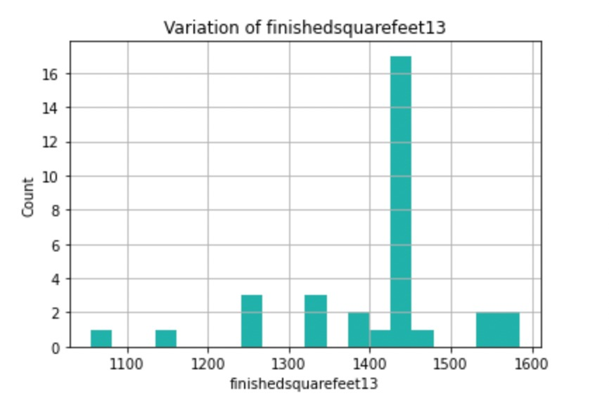
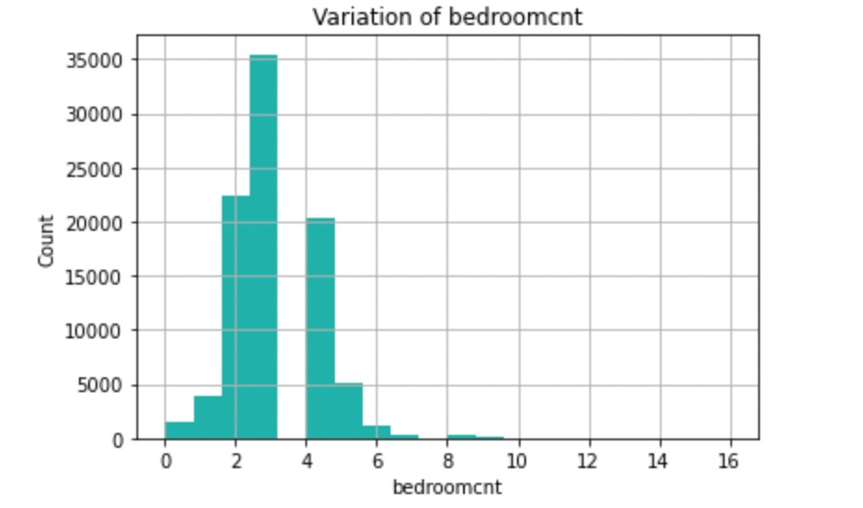
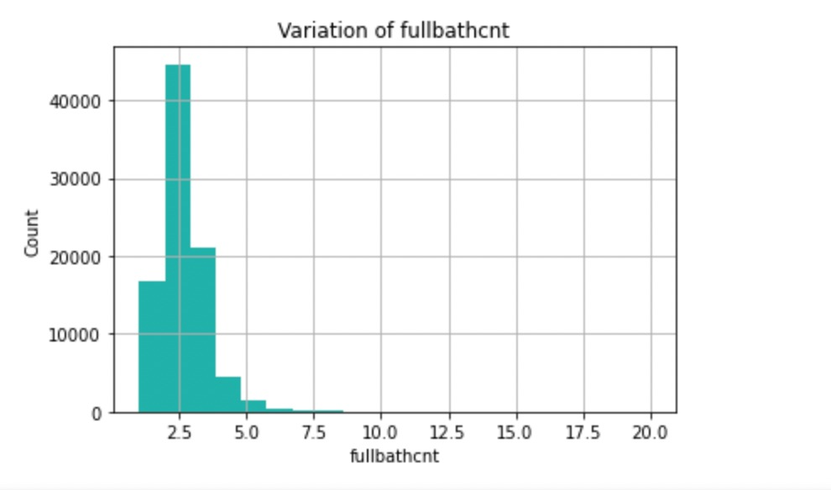
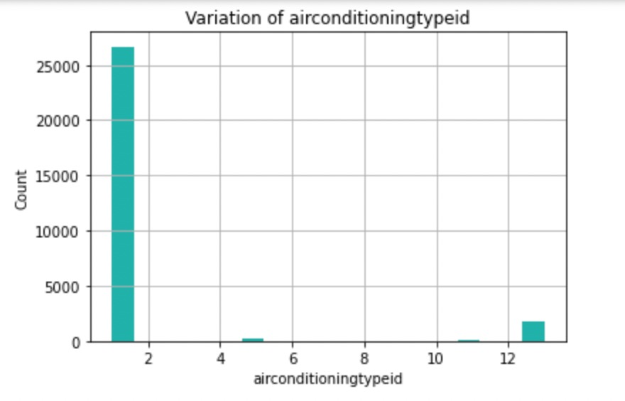
Distribution of Discrete Variables

Slide 15
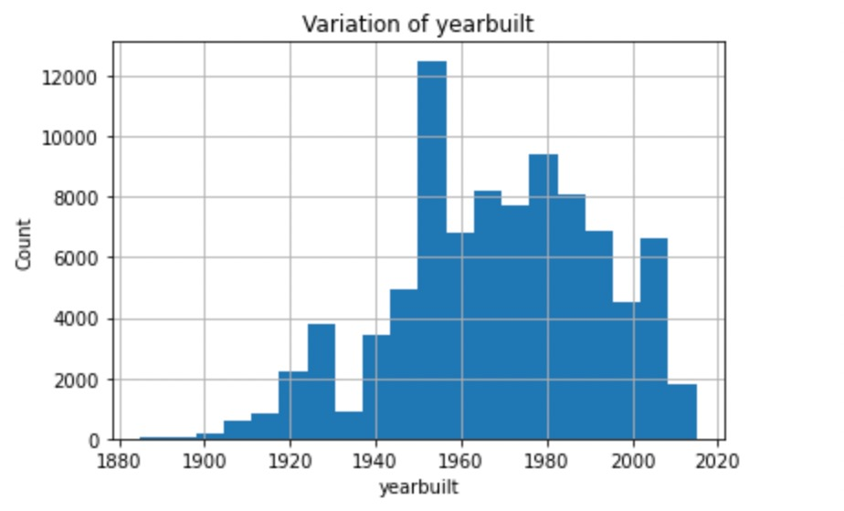
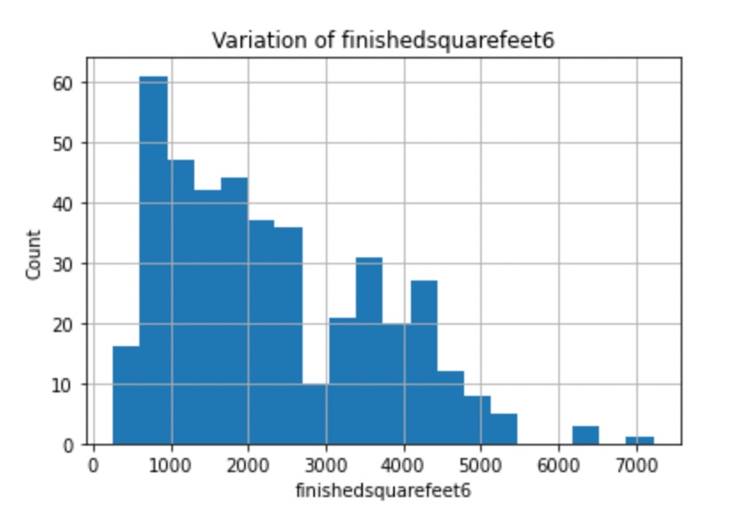
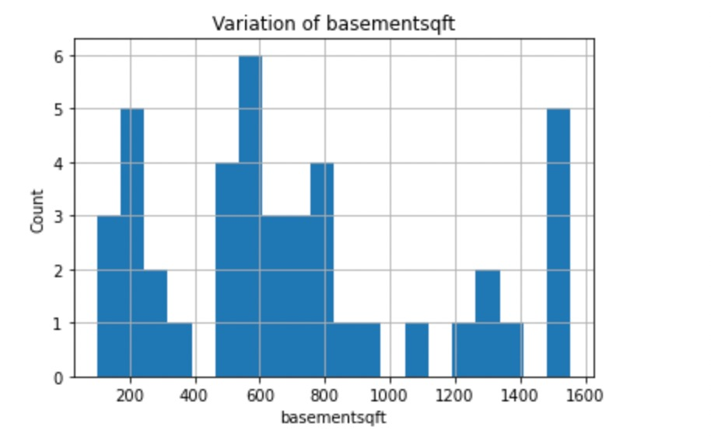
Distribution of Continuous Variables

Slide 16
Plan of action
Every row entry is linked to location information, geolocation data attributes can be used to form clusters
Feature Engineering to identify best house attributes to boost house sale
Use Regression model for predicting sale price
Thank you

